Slide 1
Reinforcement Learning: (How) Does it work? CS 4641
Kaushik Subramanian

Slide 2
Outline
Q-learning & SARSA (Recap)
What makes RL hard?
Scaling RL

Slide 3
Outline
Q-learning & SARSA (Recap)
What makes RL hard?
Scaling RL

Slide 4


Q-learning
Model-based RL
Model-free RL (Watkins, 1989)

Slide 5



Q-learning (Derivation)

Slide 6




Q-learning
Q | A1 | A2 | A3
S1
S2
S3
S4
.
.
Start in a state, s
Take an action, a
Go the next state, s’
Observe the reward obtained
Update the Q value

Slide 7
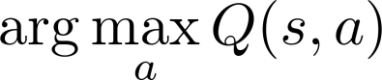
Action Selection
ϵ-greedy method
Choose a value for ϵ between 0 and 1 (fixed)
Sample a random number between 0 and 1, rand
If rand < ϵ
Take a random action
Else
Choose the action that you think is best,
Decay ϵ over time
– Why?

Slide 8
Off-policy learning (?)
Agent follows a random policy when learning
Learns the Q-function of the optimal policy

Slide 9
Off-policy vs On-policy
An off-policy learner learns the value of the optimal policy independently of the agent's actions.
An on-policy learner learns the value of the policy being carried out by the agent, including the exploration steps. (SARSA)

Slide 10
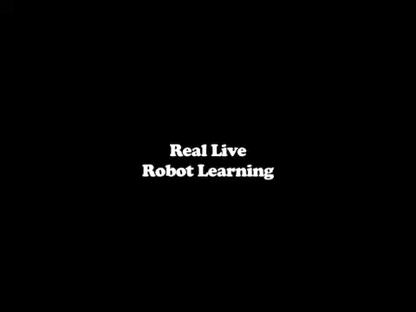
Video
Intro to RL video – by yours truly

Slide 11
Outline
Q-learning & SARSA (Recap)
What makes RL hard?
Scaling RL

Slide 12
What makes RL hard?

Slide 13
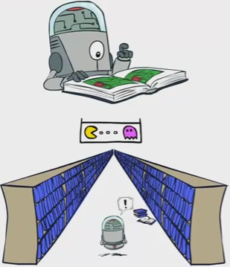
Representation
[Image Source - CS188 Artificial Intelligence, Prof. Pieter Abbeel @ UC Berkeley]

Slide 14
Representation
Complexity of VI and PI?
Quadratic! in the number of states
Q-learning - guaranteed to converge only after visiting every state-action pair infinite times
Continuous states, continuous actions - make the problem exponentially hard to learn.

Slide 15
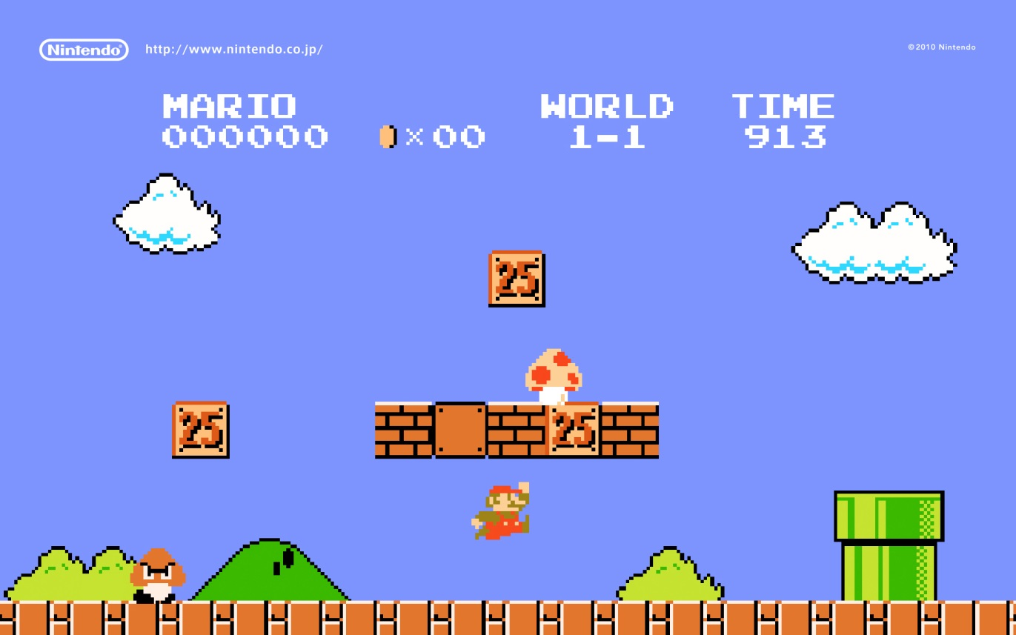
Representation
Examples of different kinds of representation?

Slide 16
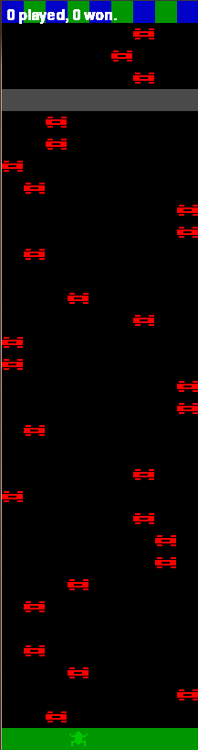
Temporal Delay
Along with a large number of states, there is a temporal aspect of decision making.
The longer the task, the longer it takes for the reward to be propagated

Slide 17
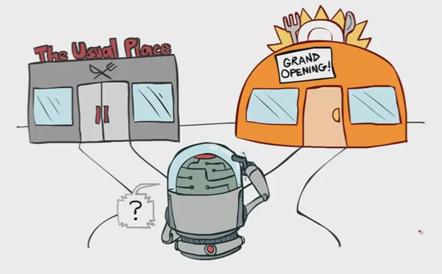

Exploration vs Exploitation
How do we control when to explore and when to exploit?
Domains can be stochastic
[Image Source - CS188 Artificial Intelligence, Prof. Pieter Abbeel @ UC Berkeley]

Slide 18
What makes RL hard?
Representation
Temporal delay
Exploration vs Exploitation
How do we tackle these problems?

Slide 19
Outline
Recap RL basics
Q-learning & SARSA
What makes RL hard?
Scaling RL

Slide 20

Scaling RL
The problems we are interested in tackling

Slide 21
Outline
Recap RL basics
Q-learning & SARSA
What makes RL hard?
Scaling RL
Supervised learning
Hierarchical Reinforcement Learning
Monte Carlo Methods

Slide 22
Supervised Learning
How is this helpful?
Use machine learning to perform generalization
Predicting value based on a few states
Neural networks
Decision Trees
Gradient descent

Slide 23
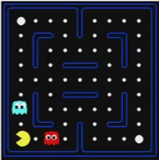
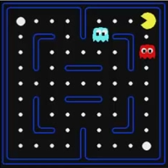
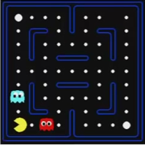
Generalization
Learn the value for a state
Generalize it to “similar” states
This is what we do in classification/regression
With good features, can be very powerful!
CS 3600, PacMan RL project

Slide 24
Outline
Recap RL basics
Q-learning & SARSA
What makes RL hard?
Scaling RL
Supervised learning
Hierarchical Reinforcement Learning
Monte Carlo Methods

Slide 25
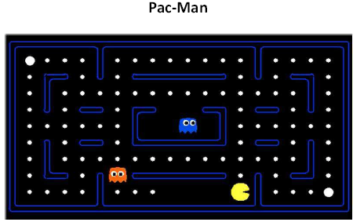
Hierarchical Reinforcement Learning
↑
↓
←
→
?
?
?
←
←
↓
↓
→

Slide 26
Temporal Abstraction
Extended temporal sequence of actions: Options
Consist of three components: <I, π, β>
I(s) is the initiation set,
π: S x A → [0 1] is the option’s policy,
β(s) is the termination set
Option
S₁
S₂
S₃
S₄
A
A
A

Slide 27
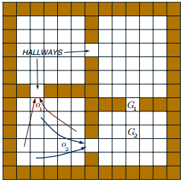
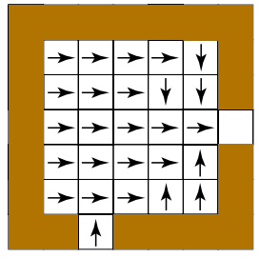
Planning with Options
How do we sequence the options to complete the task?
The hallway domain
Image Source – Rich Sutton JAIR 1998

Slide 28
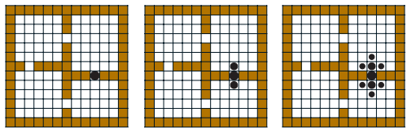
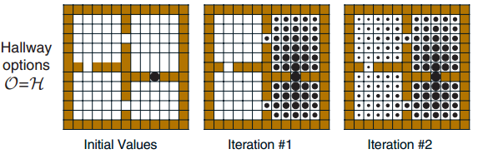
Planning with Options
Value Iteration
Primitive actions
Image Source – Rich Sutton JAIR 1998

Slide 29
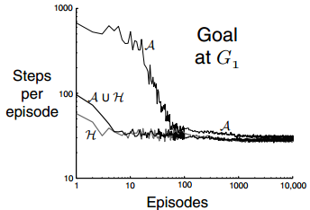
Advantages
Significant speedup in planning time
Options can be learned automatically
Incorporates temporal abstractions formally in RL
Similar to the ways humans approach problems
Image Source – Rich Sutton JAIR 1998

Slide 30
Outline
Recap RL basics
Q-learning & SARSA
What makes RL hard?
Scaling RL
Supervised learning
Hierarchical Reinforcement Learning
Monte Carlo Methods

Slide 31
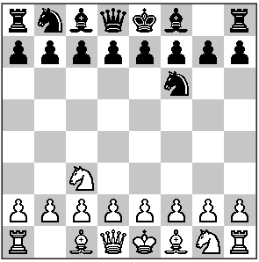
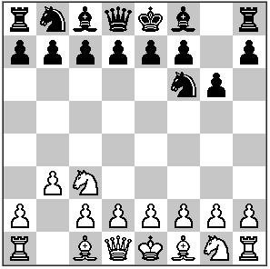
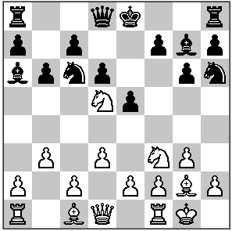
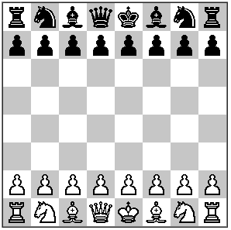
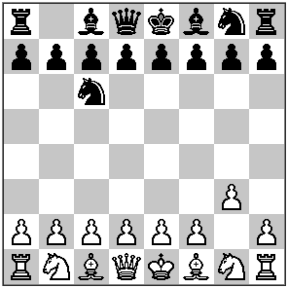
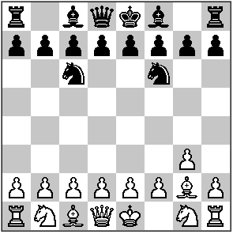
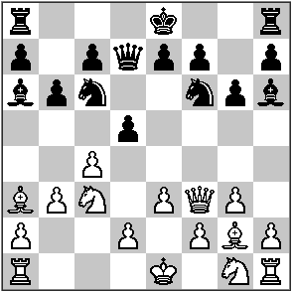
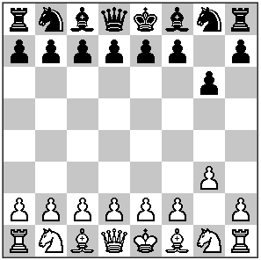
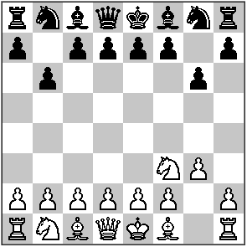
Monte Carlo Methods - Playing Chess
…………….
…………….
… Not promising

Slide 32
Monte Carlo Approach
Learning from simulated experience
Needs a simulator
Computes the same value function as RL methods
A form of policy iteration
evaluate an arbitrary policy
improve it
MCTS can be broken down into four steps

Slide 33
Monte Carlo Approach
S₁
Selection
Expansion
Simulation*
Backpropagation
(Bellman’s equation)
A₁
A₂
A₃
Depth 1
S₁
S₂
S₃
A₁
A₂
A₁
Depth 2
S₄
S₅
S₉
A₁
A₂
Depth 3
S₆
S₈
Rollout
Depth ‘n’ horizon
S_{T}

Slide 34
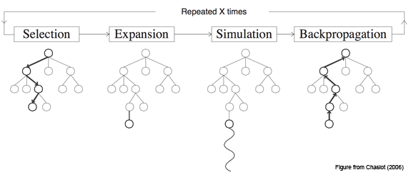
MCTS Algorithm
Where is it useful?
For problems with large state spaces
Does the planning time depend on the number of states?
Requires lots of samples to get a good estimate
What does the complexity depend on?
NO
HORIZON

Slide 35
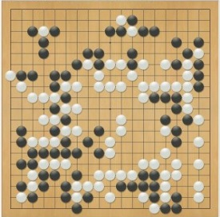
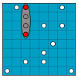
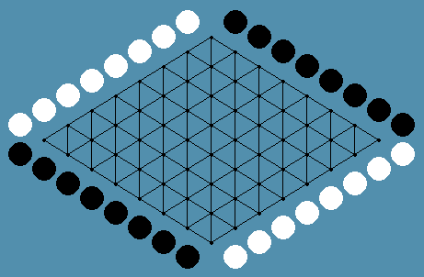
Applications
Computer Go
Ranked 6th in 2012 among professional human players and other computer programs
9x9 board has 1.039×10³⁸ legal positions
Battleship
10x10 grid with 100 moves, MCTS sank all the ships 50 moves faster, on average, than random play
Hex
Won silver and gold in the 2008 and 2009 Hex Computer Olympiads, are better than human players.

Slide 36

What we can do
Autonomous Helicopter

Slide 37
Summary
Solve sequential decision making tasks
Maximize reward, MDP, Bellman equation
Model-based and Model-free RL
RL on real-world problems is hard
But we may be up to the task!

Slide 38

Questions?

